Slide 1
TRADITION OF WATER CONSERVATION

Slide 2
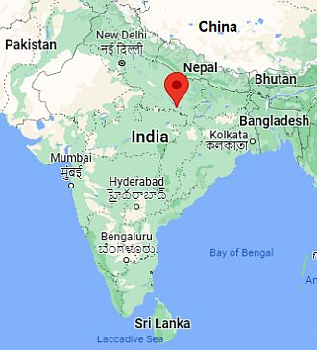
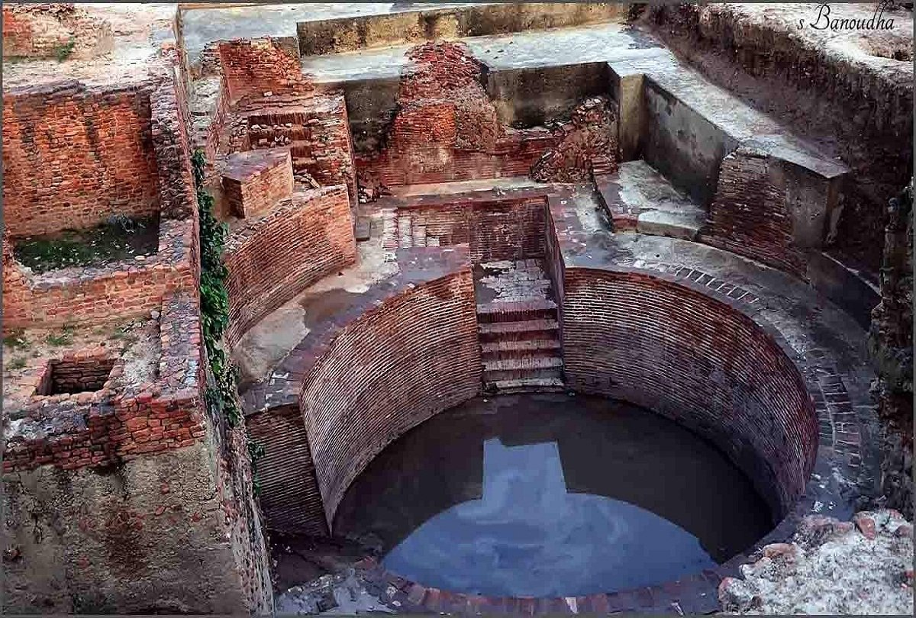
Sringaverapura near Allahabad

Slide 3
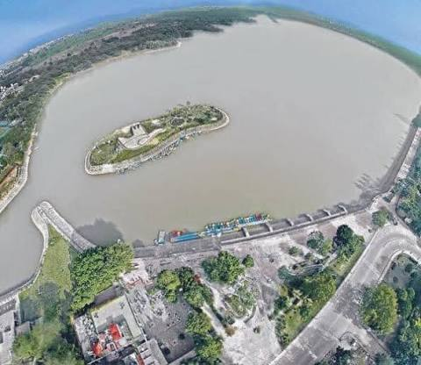
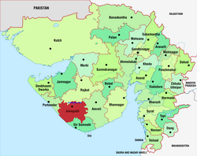
Sudarshana Lake
https://www.youtube.com/shorts/JYoOsKSEOnQ?feature=share

Slide 4
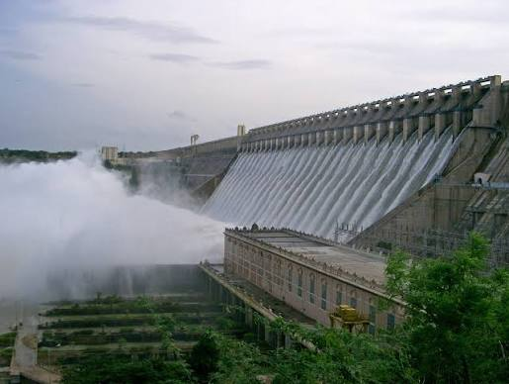
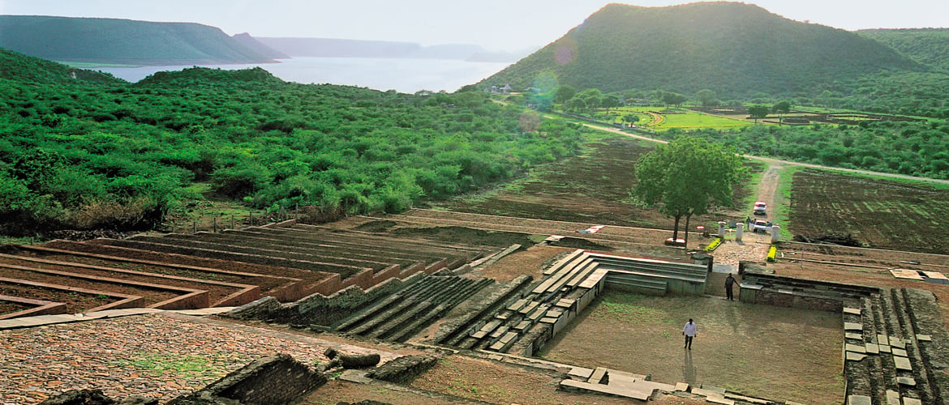
Nagarjunakonda (Andhra Pradesh) was a secluded valley with a small hamlet called Pullareddigudem when the ancient structures were discovered here. In 1954.

Slide 5
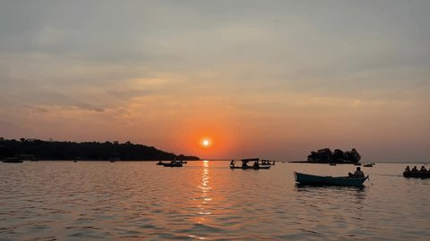
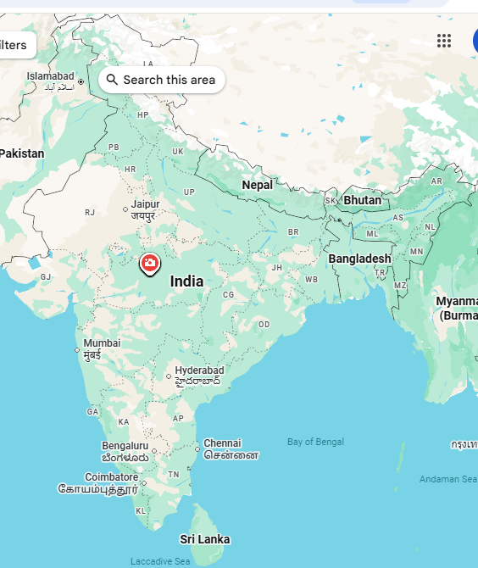
In the 11th Century, Bhopal Lake, one of the largest artificial lakes of its time was built.

Slide 6
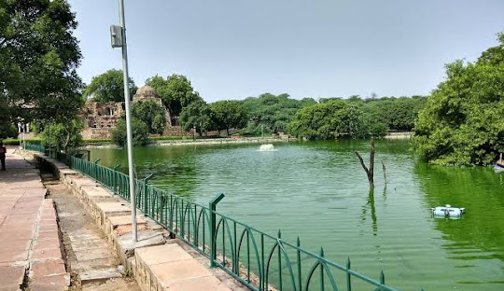
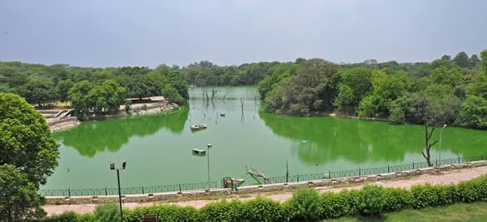
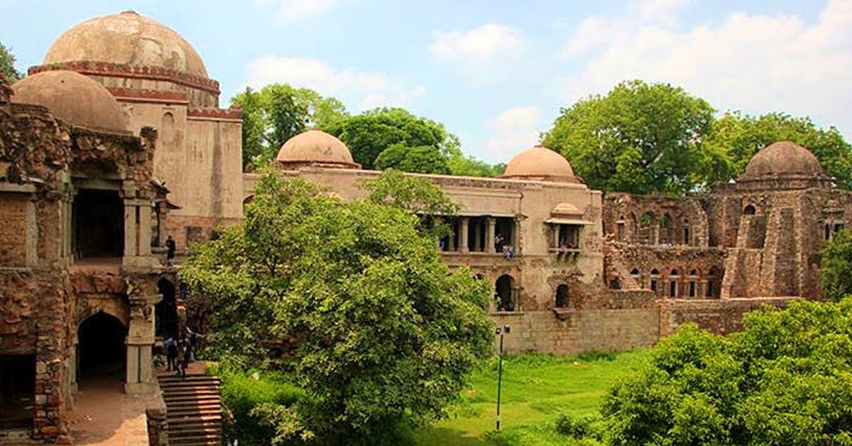
In the 13th–14th Century, the tank in Hauz Khas, Delhi was constructed by Allauddin Khilji (Khalji) for supplying water to Siri Fort area.

